Slide 1

GRAPHIC INTERFACe For De Casteljau and De Boor algotithms
MASsimiliano Sirgiovanni

Slide 2
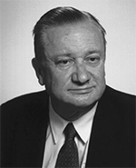

Preliminary operations
Before realizing the real interface, it was obviously necessary to implement the algorithms of De Casteljau and De Boor in the case of curves and surfaces .
The two algorithms are very similar to each other and have the purpose of evaluating the points of a curve (or surface).
De Casteljau's Algorithm is responsible for studying Bèzier curves (or surfaces) and uses the principle of parabola arcs.
De Boor's Algotithm is used for evaluating B-Spline curves (or surfaces) lowering the order of the B-Spline to 1 by k-1 steps.
The implementations have been carried out using the dictates of the theory seen in class.
In general, attempts have always been made to exploit the locality properties of the algorithms to search for the required point with as few steps as possible.
Furthermore, the algorithms have been implemented in such a way that the various steps of the algorithm can be shown graphically to the user, step by step.

Slide 3
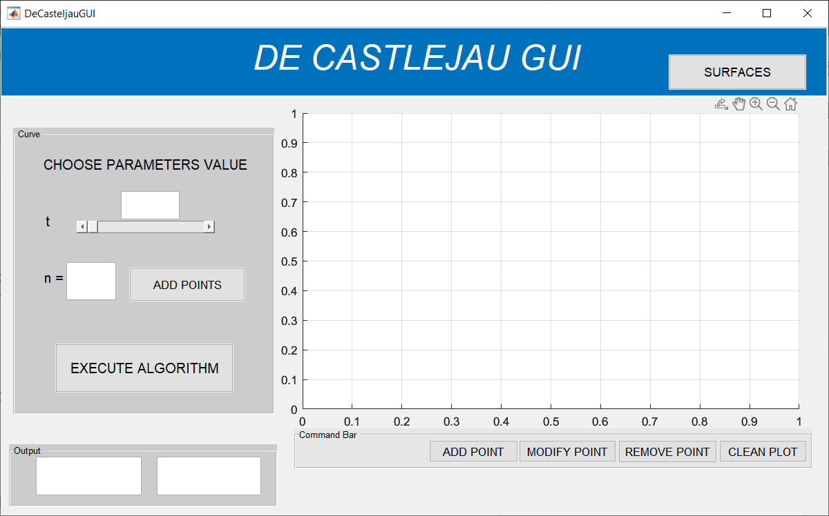

Slide 4


Slide 5
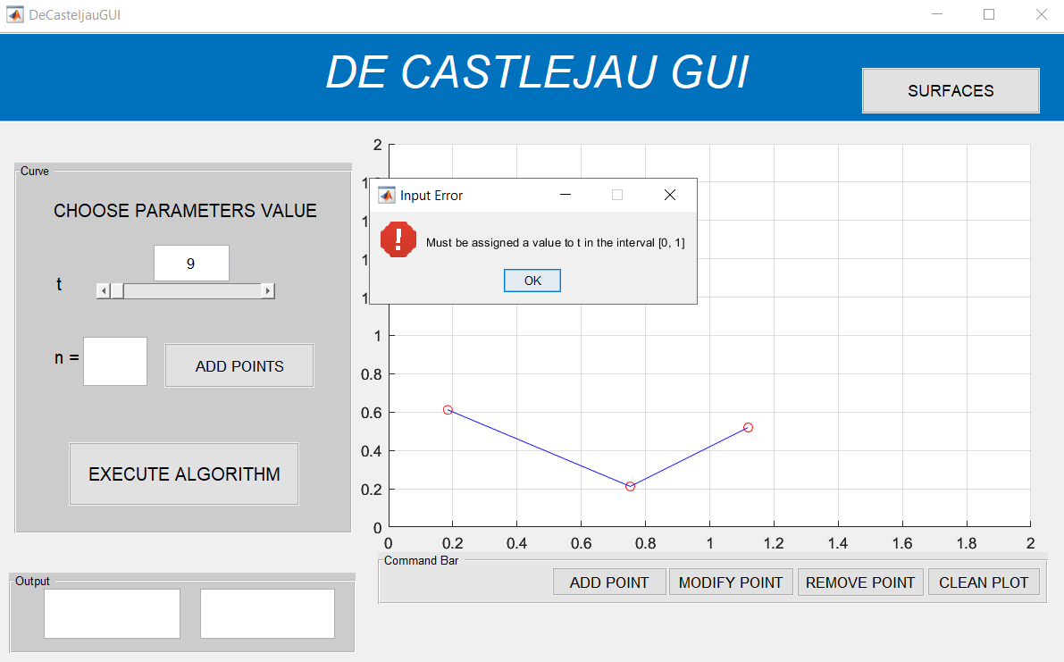

Slide 6


Slide 7
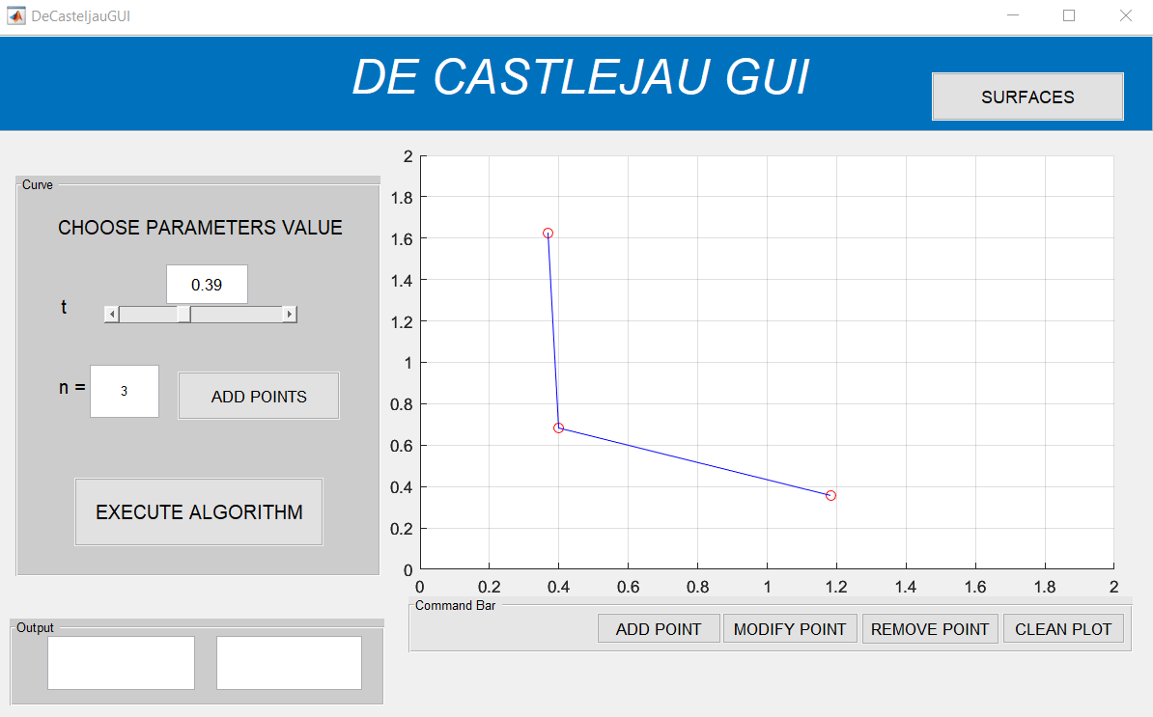

Slide 8


Slide 9


Slide 10
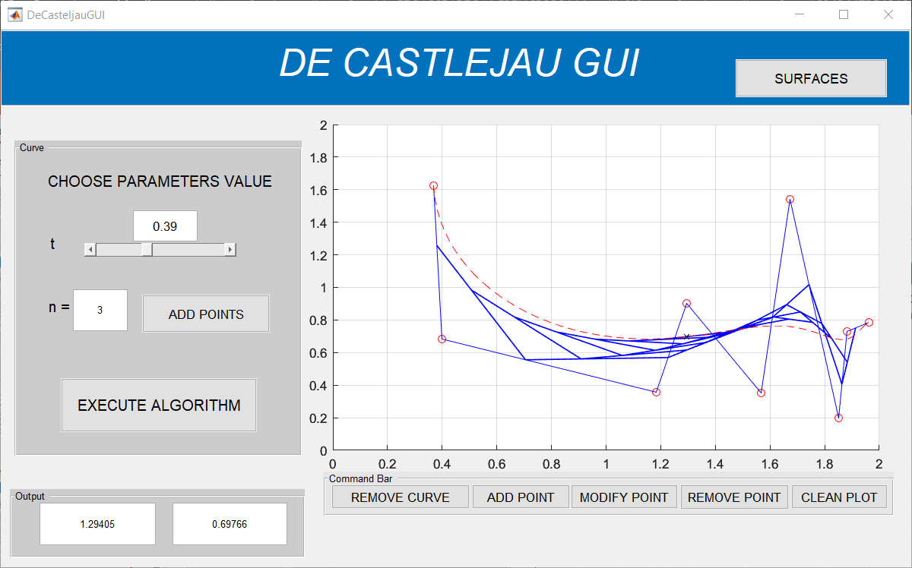

Slide 11
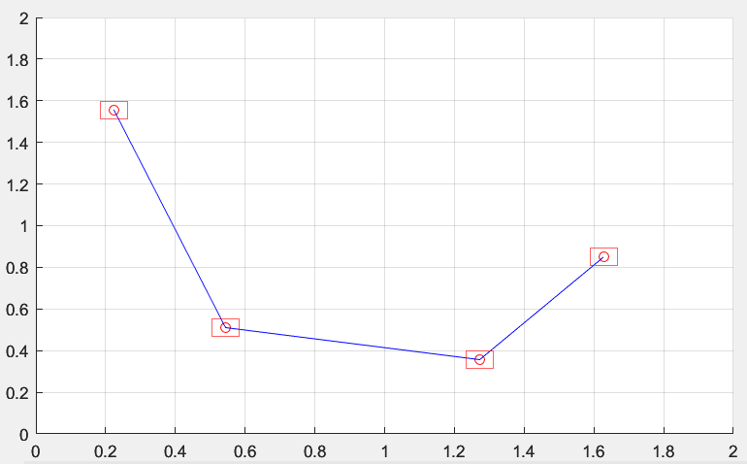
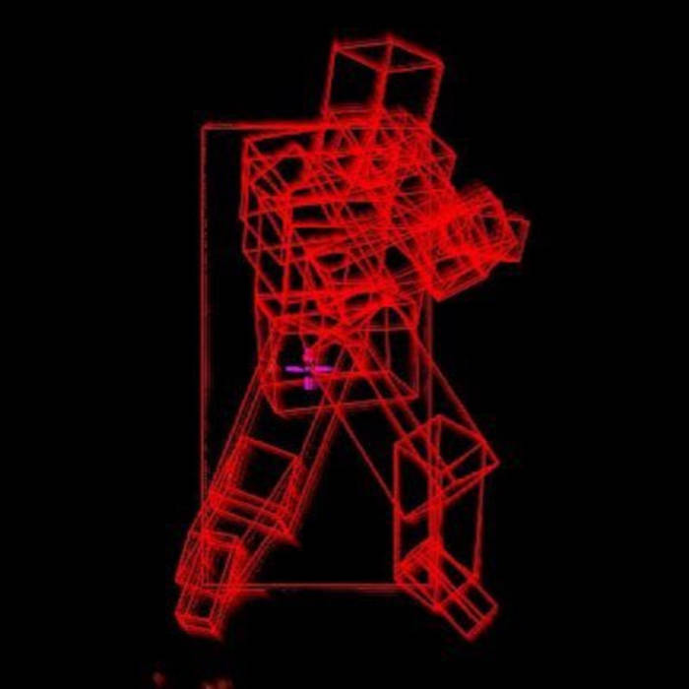
REMOVING AND CHANGING POINTS
The most complicated operation is selecting the point on which to make the changes.
To do this, we took inspiration from the hitbox technique.
In fact, areas have been created around the points, represented as squares.
To select a point, it will be sufficient to use a ginput() and select one of the points contained in the area of a square.
This will select the corresponding point.
Once the point has been selected, it will be possible to carry out the required operations (deletion or modification) in the corresponding position of the point vector.

Slide 12
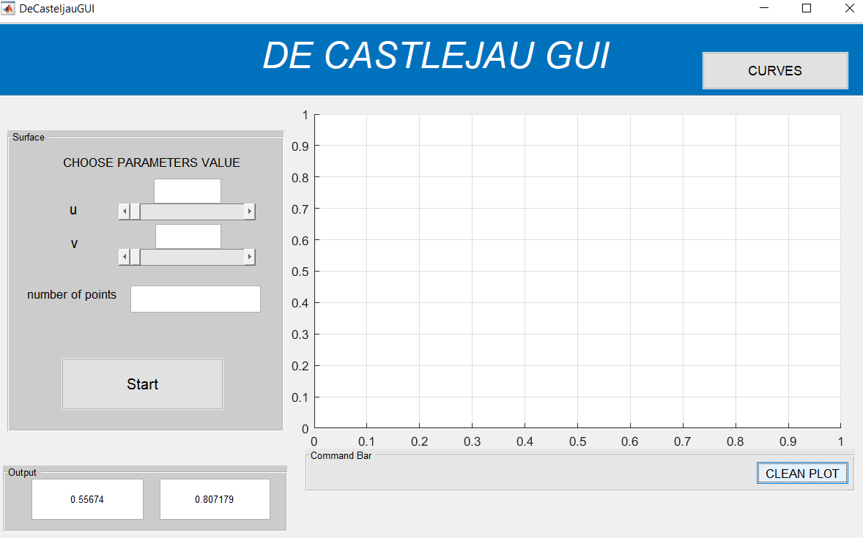
Superfici

Slide 13
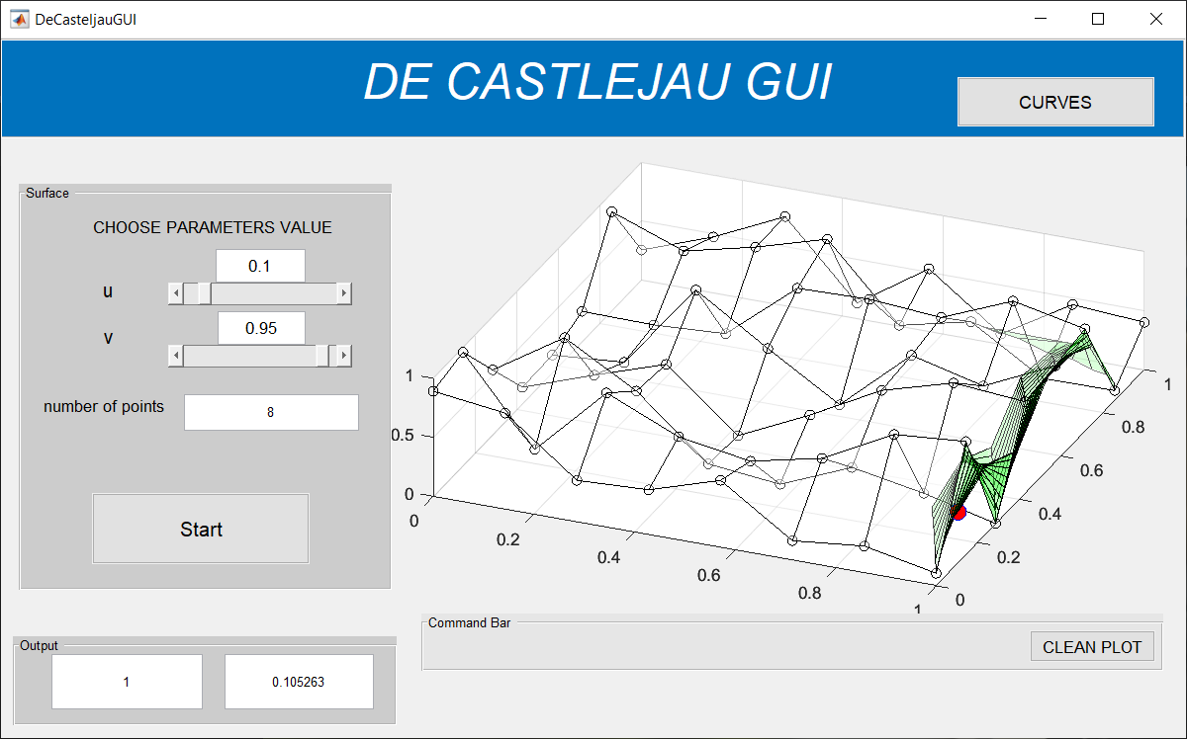
Superfici

Slide 14
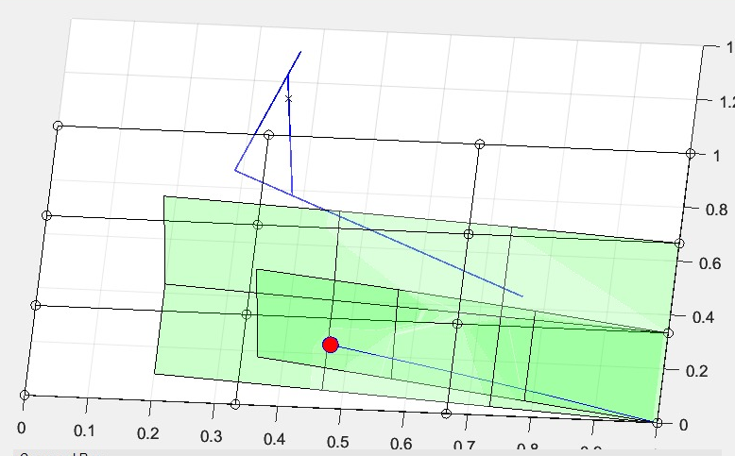
OVERLAPPING OF THE FIGURES
Due to the presence of some "pause" instructions, it was possible to find oneself in a situation like the one seen in the figure:
However, this situation has been solved through the use of a global variable, "iteration".
This variable allows you to check for the presence of nested flows.
In fact, it is set to the value one every time the execution of an operation begins and set to zero every time an execution ends.
Therefore, after performing a "pause", a check is made on this variable, which if set to zero will imply that there was a nested flow and therefore all nested executions can be terminated.

Slide 15

De Boor

Slide 16
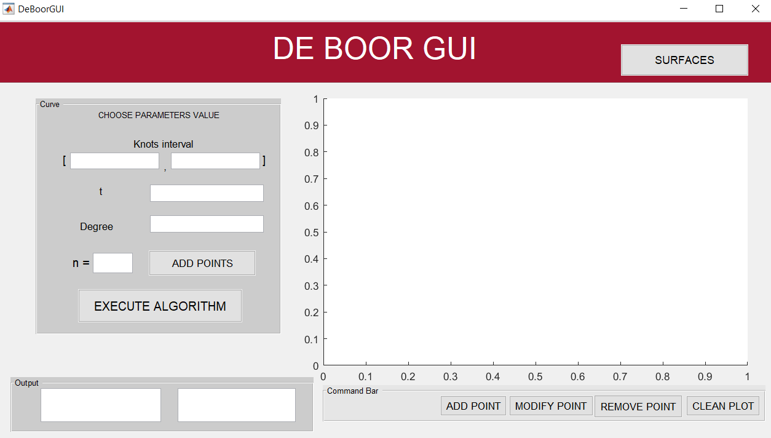

Slide 17
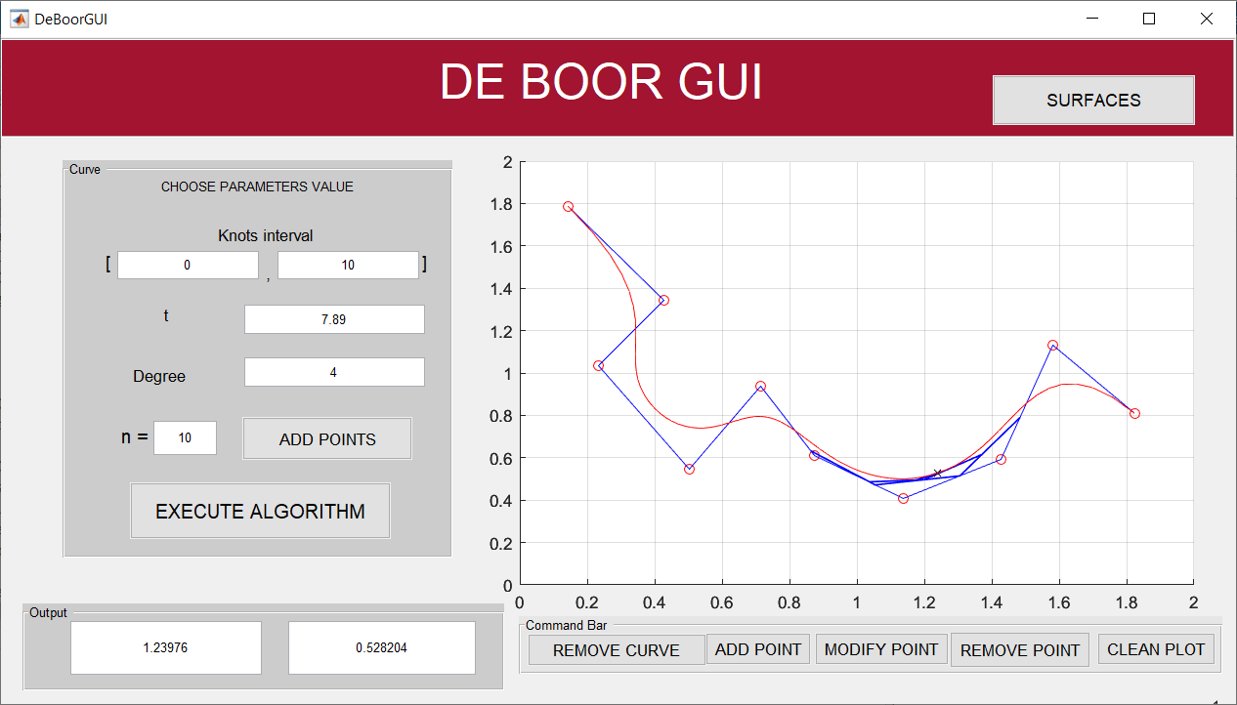

Slide 18
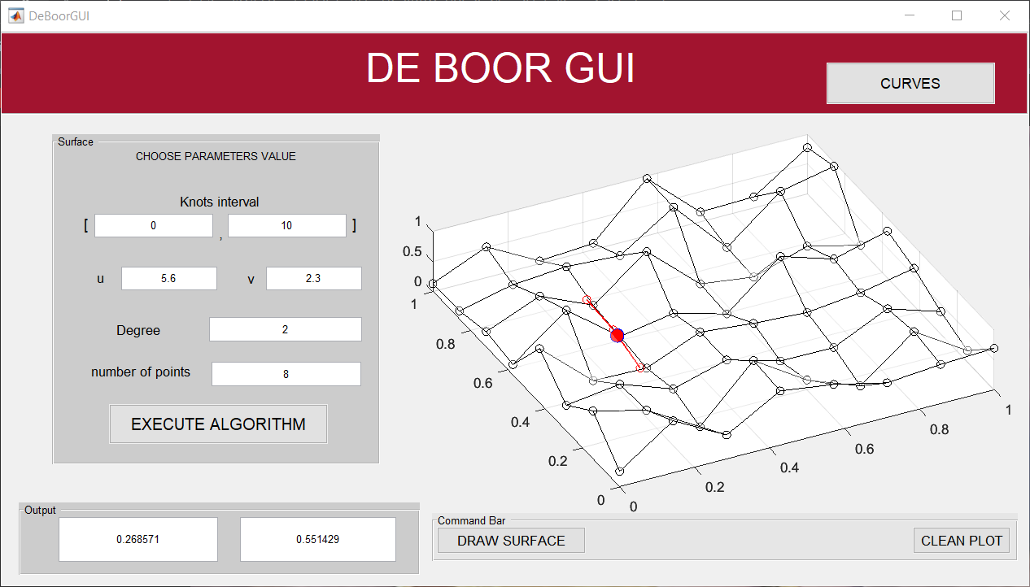
Superfici

